Slide 1
MAKERERE UNIVERSITY MAKERERE UNIVERSITY BUSINESS SCHOOL FACULTY OF COMPUTING AND INFORMATICS DEPARTMENT OF APPLIED COMPUTING AND IT
BACHELOR OF COMMERCE (BUC1112)
SEMESTER: II, ACADEMIC YEAR: 2024/2025.
FUNDAMENTALS OF INFORMATION COMMUNICATION TECHNOLOGY

Slide 2
Introduction to ICT and Key Concepts
Definition of ICT, IS, IT:
Importance of ICT/IS/IT
Data and Information:
Data Processing:
ICT for Sustainable Development Goals (ICT4SDGs):

Slide 3
Introduction to ICT and Key Concepts
Definition of ICT, IS, IT
Data and Information
Data Processing
ICT for Sustainable Development Goals (ICT4SDGs)

Slide 4
ICT defined
ICT is being defined by many scholars & technology specialists as consisting of hardware, software, telecommunications, database management, & other information processing technologies used in computer-based information systems.
It involves the dynamic interaction of computer based information systems while telecommunications forms the backbone of ICT.
Why is telecommunications considered the backbone of ICT?
Notes:
ICT is concerned with the storage, retrieval, manipulation, transmission or receipt of digital data

Slide 5
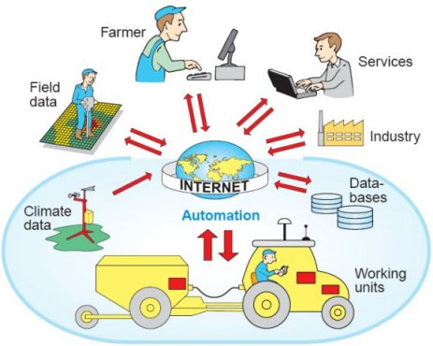
ICT

Slide 6
ICT Consists of…
IT
Telephony(technology that allows us to connect using audio signals from afar ie; electronic transmission of voice, fax, or data, between distant parties)
Broadcast media (different media channels or broadcasters such as the television, internet, audio podcasts, video content, and others.)
all types of audio and video processing and transmission and network based control and monitoring functions

Slide 7
Information Technology (IT) Defined
An acronym that stands for information technology
IT is the use of computer hardware and computer software to convert, store, protect, process, transmit, and retrieve information.
IT involves the acquisition, processing, storage and dissemination of vocal, pictorial, textual and numerical information.

Slide 8
Information System (IS) defined
Information system is defined as any organized combination of people, hardware, software, communications network, and data resources to perform the activities of input, processing, output, and control activities that collect, transform data resources into information products in an organization or disseminates information in an organization.
Just visualize the types of IS in your locality.

Slide 9
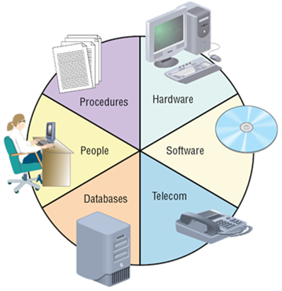
Information Systems

Slide 10
Introduction to ICT and Key Concepts
Definition of ICT, IS, IT:
Importance of ICT/IS/IT
Data and Information:
Data Processing:
ICT for Sustainable Development Goals (ICT4SDGs):

Slide 11
Importance of IT in different Business/ Reasons for studying ICT in the University
To ensure ICT supports the organization’s corporate strategy.
To identify strategic competitive advantage opportunities.
Ensure linkage between business and ICT.
Provide leadership for ICT projects.

Slide 12
Strategic Uses of ICT / IS
Improving Business Processes and Cost Reduction.
Promote Business Innovation.
Locking in Customers and Suppliers.
Creating Switching Costs. (Substitutes, Alternatives)E-commerce platforms eg. Amazon prime—Subscribers enjoy benefits like fast shipping, exclusive deals, and access to Prime video. The convenience associated with subscriptions creates switching costs by opting for different e-commerce platforms. These are financial costs incurred by a consumer when they switch brands, products, services or suppliers.
Raising Barrier to Entry. Don’t let your competitors easily enter an industry or area of business. Eg Trade secrets
Leveraging a Strategic IT Platform.
Developing a Strategic Information Base. This helps companies establish long-term or strategic goals that contribute to decision-making.
Training. Aids in training and retaining workers using multimedia.

Slide 13
Strategic Uses of IT
Improving
Business
Process
Promote
Business
Innovation
Locking in
Customers
and Suppliers
Strategy
IT Role
Use IT to reduce costs of doing business
Use IT to create new products or services
a)Use IT to improve quality
b)Use IT to link business to customers and suppliers
Create New
Business
Opportunities
Maintain Valuable
Customers and
Relationships
Outcome
Enhance
Efficiency

Slide 14
Strategic Uses of IT Cont’
Raise
Barriers
to Entry
Build a
Strategic IT
Platform
Build a
Strategic
Information Base
Strategy
IT Role
Increase amount of investment or complexity of IT needed to compete
Leverage investment in IS resources from operational uses to strategic uses
Use IT to provide information to support firm’s competitive strategy
Create New
Business
Opportunities
Enhance
Organizational
Collaboration
Outcome
Increase
Market Share

Slide 15
Introduction to ICT and Key Concepts
Definition of ICT, IS, IT
Data and Information
Data Processing
ICT for Sustainable Development Goals (ICT4SDGs)

Slide 16
Data defined
Data are raw facts, unprocessed facts or observations, typically about physical phenomena or business transactions.
Data can be stored, transmitted, and presented in an infinite variety of forms and formats, including numeric, alphabetic, alphanumeric, image, audio, video and electronic pulses etc.
Examples of data might include; registration numbers of students at MUBS, account balances of a company’s debtors etc

Slide 17
Why Data is Critical
TPS for gathering about internal operations and corporate data bases to support planning and control activities in an enterprise. Eg ATM, Ticket reservations etc
Data and information about each transaction has to be recorded so that the business can be properly managed.
At the planning stage, data and information is important as a key ingredient in decision making.

Slide 18
Cont’ Why Data is Critical
Organizations engage in EDI (Electronic Data interchange).Allows the sending of information electronically from one enterprise to another. These data become input to the TPS and may be used to update corporate databases.
Data is used as the main way of measuring performance in order for a business to succeed.
In order to monitor progress against the plan and control resources, we need data.

Slide 19
Information defined
Information can be defined as data that have been converted into meaningful and useful context for specific end users.
It is processed data which has been placed in a context that gives it value for specific end users.
Data are raw facts, unprocessed facts or observations, typically about physical phenomena or business transactions.
Examples of data and information in business/Office environment.
Notes:
Data is the collection of raw facts and figures. It is without any proper meaning. Data may be collection of words, numbers, graphics or sounds.
Students data on admission, Data of Citizens, Survey Data, Students Examination Data.
Information: Processed data is called information. When raw facts and figures are processed and arranged in some order then they become information. Information has proper meanings. Information is useful in decision-making.
Student results slip, Census report, survey reports etc

Slide 20
Information Products & Information Quality
Information product: Information product is the degree to which information has the appropriate information that is useful for users e.g. messages, reports, forms, & graphic images.
Information quality: Information quality is the degree to which information has content, form, and time characteristics that gives it value to specific end users.

Slide 21
Characteristics/Attributes of Information
Time Dimension: Timeliness; currency; frequency
Content Dimension: accuracy; relevance; completeness; auditability; conciseness
Form Dimension: clarity; detail; order; presentation and media.

Slide 22
Elements/Aspects of Information Qualities of good information.
Accurate for purpose; managers rely on information to effectively manage their 'value-adding' activities and free of errors.
Currency, that is, information should be up-to-date when it is provided.
Communicated in an appropriate channel; for a manager to use information effectively it must be transmitted in the communication process.

Slide 23
Qualities Cont’
Understandable; managers can only use information to good effect if they understand its purpose.
Relevance for purpose; information should always be relevant to the issue being considered.
Auditability; auditability of data refers to the ability to verify the accuracy and completeness of the data.

Slide 24
Qualities Cont’
Timely; for effective decisions to be taken, information needs to be reported to management on a timely basis.
Ease to understand or clarity, that is, information should be provided in a form that is easy to understand.
Completeness; it is desirable that all information required for decision making is made available.

Slide 25
Qualities Cont’
Communicated to the right person; managers have a clear & defined level of responsibility & must achieve their predetermined objectives.
Cost-effective; the costs of providing the information must not outweigh the 'value-added' benefits derived from its use.
Others include: frequency, reputable source, volume, conciseness, performance, detail, order, presentation, scope and media etc.

Slide 26
Introduction to ICT and Key Concepts
Definition of ICT, IS, IT
Data and Information
Data Processing
ICT for Sustainable Development Goals (ICT4SDGs)

Slide 27
Data Processing defined
Data processing is the process of producing meaningful information by collecting all items of data together and performing operation on them to extract the required information about them.
The major modes of data processing today are batch processing, distributed, centralized and real-time or online processing modes.

Slide 28
Data Processing Cycle / Process
Origination of data which looks at the sources of data e.g. customer orders; goods received notes, price lists, etc.
Preparation of data; that is, getting the data ready for input e.g. thru sorting, editing, etc.
Input of data which is the act of passing the data to the processor in the processing stage. This could be by the clerk on the computer through the use of the keyboard.

Slide 29
Data Processing Cycle / Process Cont’
Processing which includes all the necessary operations to arrive at the end-product (information) and to keep data up to-date.
Lastly, output which involves the production of the end product e.g. annual reports, financial statements, payroll, etc.
Data processing Methods
Manual
Mechanical
Electronic
Data processing modes
Real-time, Centralized, distributed, time-sharing, batch processing, multitasking, multiprocessing

Slide 30
DATA PROCESSING METHODS
Manual: In this method data is processed manually. The entire processing task like calculation, sorting and filtering, and logical operations are performed manually without using any tool or electronic devices or automation software. Eg paper writing(LPO),receipts
Mechanical – In this method data is not processed manually but done with the help of very simple electronic devices and a mechanical device like calculator and typewriters.
Electronic – This is the fastest method of data processing and also modern technology with the modern required features like highest reliability and accuracy. Eg Banking transactions, stock inventory, Bar code readers

Slide 31
DATA PROCESSING MODES
Batch Processing; processing a large volume of data at once E.g. payroll processing, billing, and generating reports.
Real-time Processing; processing data as soon as it is received, without any delay. E.g. Online transactions(Bank ATMs, safe boda, online registration)

Slide 32
DATA PROCESSING MODES CONT’
Multiprocessing/parallel; breaks down large data sets into smaller units simultaneously on a network. Eg Banks using one printer
Distributed Processing; involves distributing data processing tasks across multiple computers or servers. Linked to central unit(web application, data warehousing, and cloud computing).
Time sharing processing; allocates computer resources and data in time slots to several users simultaneously. (one is used by several users but time allocated to users differs)

Slide 33
Importance of good information
Strategic decision-making; identify trends, opportunities, and threats, and make strategic decisions.
Market research: to understand customer needs, preferences, and behaviors.
Financial management: Financial statements, budgets, and cash flow projections are all based on information gathered from various sources.

Slide 34
Importance of good information cont’
Supply chain management: By tracking inventory levels, shipping times, and supplier performance
Employee management: tracking performance, managing schedules, and providing training and development opportunities.

Slide 35
Introduction to ICT and Key Concepts
Definition of ICT, IS, IT
Data and Information
Data Processing
ICT for Sustainable Development Goals (ICT4SDGs)

Slide 36
ICT for Sustainable Development Goals (ICT for SDGs)
The Sustainable Development Goals (SDGs)/Global Goals, are a universal call to action to end poverty, protect the planet and ensure that all people enjoy peace and prosperity.

Slide 37
These 17 Goals are based on the Millennium Development Goals, with additional emphasis on climate change, economic inequality, innovation, sustainable consumption, peace and justice.

Slide 38
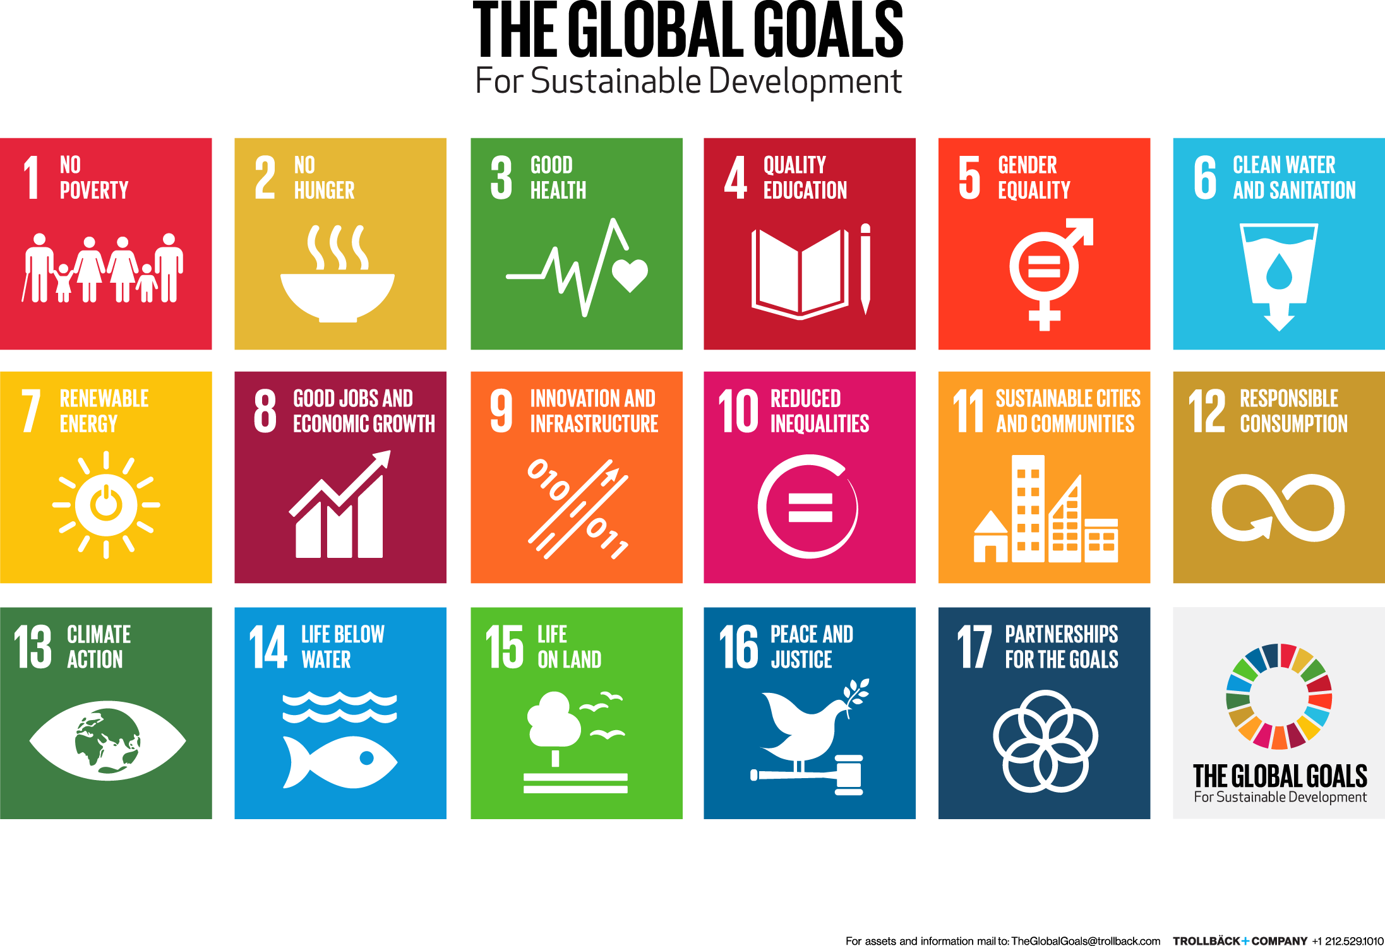

Slide 39
ICT4SDGs
ICTs form the backbone of today's digital economy and have enormous potential to fast forward progress on the SDGs and improve people's lives in fundamental ways.
“ICTs are the main enablers that will accelerate the achievement of all 17 Sustainable Development Goals (SDGs), and the voices of people must be included”, Majed Sultan Al Mesmar, 2018.

Slide 40
Through digital financial services, many unbanked people are participating in the digital economy for the first time; and access to financial services has proven to be a pivotal step in helping people lead out of poverty. In addition, timely and accurate information services will help ensure equal rights to economic resources and market insights that can benefit all.​
Job creation
Information services brought closer

Slide 41
To feed a growing population, agriculture is increasingly knowledge-intensive. ICTs help farmers improve crop yields and business productivity through better access to market information, weather forecasts, training programmes, and other online content tailored to their needs.

Slide 42
​ICTs have the potential to deliver benefits across the global healthcare ecosystem. Patients can contact health care services remotely regardless of their proximity to a healthcare centre. Health care workers can, for example, learn and prepare for disease outbreaks, identify patient symptoms, follow established treatment protocols, perform remote diagnostics, access expert support and so on. Big Data analytics can help produce snapshots, analyze trends, and make projections about disease outbreaks, health service usage, and patient knowledge, attitudes, and practices.

Slide 43
ICTs are powering a revolution in digital learning, which has become one of the world's fastest-growing industries. Mobile devices now allow students to access learning assets anytime, anywhere. Teachers are now using mobile devices for everything from literacy and numerical training to interactive tutoring. Indeed, mobile learning has the ability to help break down economic barriers, divides between rural and urban, as well as the gender divide.

Slide 44
ICTs can provide great opportunities for gender equality by enabling everyone to have access to the same online resources and opportunities. They enable women to gain a stronger voice in their communities, their government and at the global level. ICTs can also provide new opportunities for women’s economic empowerment by creating business and employment opportunities for women as owners and managers of ICT-accessed projects, as well as employees of new business ventures. Yet, over 250 million fewer women are online than man. The gender gap in access to ICTs needs to be urgently addressed if the benefits of ICTs to gender equality and gender empowerment are to be achieved.

Slide 45
More than 800’000 deaths are caused each year by unsafe water and poor sanitation. ICTs are particularly important for smart water management, facilitating the measurement and monitoring of water supplies as well as necessary interventions, and enabling practitioners at the local level to ensure the equitable and sustainable extension of water, sanitation and hygiene (WASH) services. As the costs of ICTs continues to fall, governments will be able to better integrate ICTs into monitoring and evaluation frameworks to optimize operations and improve the quality of service.​

Slide 46
ICTs and energy efficiency can be connected in two ways: ‘Greening of ICTs’ and ‘Greening through ICTs’. In the first case, ICTs are being transformed and developed to be more environmentally sound and less carbon-intensive. In the second case, ICT-enabled solutions (for example smart grids, smart buildings, smart logistics and industrial processes) are helping to transform the world towards a more sustainable and energy efficient future. These green technologies and processes have the potential to play a significant role in significantly reducing global greenhouse gas emissions.​

Slide 47
​ICT skills have already become a prerequisite for almost all forms of employment, and ICT capacity-building must therefore be prioritized in national youth employment and entrepreneurship strategies in all countries. It is not simply that most jobs and businesses now require ICT skills, but also that ICTs themselves are transforming the way that business is being done everywhere and creating new employment opportunities.

Slide 48
To “significantly increase access to ICT and strive to provide universal and affordable access to Internet in the LDCs (least-developed countries) by 2020”. Without the digital infrastructure that powers our wireless world and forms the backbone of our digital economy, the world would not be able to deliver the ICT applications that enable scalable solutions to the SDGs. ITU believes broadband must be considered essential infrastructure for the 21st-century due to its capacity to power industry and innovation. And ITU’s role in the adopt­ing of globally harmonized spectrum and standards is essential to facilitate the development of transformative digital infrastructure, such as 5G systems, that will drive scalable solutions to all 17 SDGs..

Slide 49
ICTs have the potential to help reduce inequality both within and between countries by enabling access to information and knowledge to disadvantaged segments of society – including those living with disabilities, as well as women and girls. However, by the end of 2016, more than half of the world's population – 3.9 billion people – were not yet using the Internet and access was uneven between genders and geographically. Reducing inequalities cannot be achieved without addressing these underlying issues.​

Slide 50
With more than half the world’s population already living in urban environments, ICTs will be essential in offering innovative approaches to managing cities more effectively and holistically – through applications such as smart buildings, smart water management, intelligent transport systems, and new efficiencies in energy consumption and waste management. Using ICTs to make cities more eco-friendly and sustainable is vital – not just for the well-being of urban inhabitants, but also for the sustainability of the planet..

Slide 51
ICTs and responsible consumption and production are linked in two ways: increased dematerialization and virtualization as well as innovative ICT applications enabling sustainable production and consumption. Cloud computing, smart grids, smart metering, and reduced energy consumption of ICTs all have a positive impact on reducing our consumption. However, ICTs themselves require energy consumption. Therefore, effective policies are needed to ensure the negative impacts of ICTs, such as e-waste, are minimized.​

Slide 52
ICTs, including satellite monitoring, play a crucial role in earth monitoring, sharing climate and weather information, forecasting, and early warning systems. ICTs therefore enable both the global monitoring of climate change as well as strengthen resilience by helping mitigate the effects of climate change through forecasting and early warning systems. ​

Slide 53
ICTs can play a significant role in the conservation and sustainable use of the oceans – notably through improved monitoring and reporting which leads to increased accountability. Satellite-based monitoring delivers timely and accurate data on a global basis, while local sensors deliver on the spot updates in real-time. Big data can be used to analyse short- and long-term trends in terms of biodiversity, pollution, weather patterns and ecosystem evolution, and to plan mitigation activities.​

Slide 54
ICTs can play a significant role in the conservation and sustainable use of terrestrial ecosystems and the prevention of the loss of biodiversity – notably through improved monitoring and reporting which leads to increased accountability. Satellite-based monitoring delivers timely and accurate data on a global basis, while local sensors can deliver on the spot updates in real-time. Big data can be used to analyse short- and long-term trends in terms of biodiversity, pollution, weather patterns and ecosystem evolution, and to plan mitigation activities.​

Slide 55
ICTs can play an important role in crisis management, humanitarian aid and peace building, and have proved to be a powerful aid in areas such as electoral monitoring. The growing use of open data by governments increases transparency, empowers citizens, and helps to drive economic growth. ICTs are also essential in terms of record-keeping and tracking government data and local demographics. When natural or man-made disasters occur, ICTs are crucial in obtaining, communicating and transmitting accurate and timely crisis information, allowing appropriate responses to be made. In the future, big data analysis and data mining should allow better use to be made of the vast amount of data that is already openly accessible online.

Slide 56
ICTs are specifically mentioned as a means of implementation under SDG17, highlighting the cross-cutting transformative potential of ICTs. Indeed, ICTs are crucial in achieving all of the SDGs, since ICTs are catalysts that accelerate all three pillars of sustainable development – economic growth, social inclusion and environmental sustainability – as well as providing an innovative and effective means of implementation in today’s inter-connected world.

